Slide 1


K.RAMAKRISHNAN COLLEGE OF ENGINEERING
(AUTONOMOUS), SAMAYAPURAM - TRICHY
DEPARTMENT OF CSE
CGB1121 – PYTHON PROGRAMMING
WATER TANK LEVEL MONITORING AND USAGE SYSTEM
PRESENTED BY :
GUGANRAJ R
8115U25CS050
SUPERVISOR :
Mr.R.Indradevi
Assistant Professor/CSE.
06/03/2025
Notes:
1

Slide 2
PRESENTATION OVERVIEW
  Abstract
  Introduction
  Existing System
  Prposed System
  Modules
  Modules Description
  Architecture Diagram
  Data Flow Diagram(DFD)
  Conclusion
  Screenshots
06/03/2025
Notes:
2

Slide 3
ABSTRACT
The Smart Water Tank Level Monitoring and Usage System is a simple and useful project used to monitor and control the water level in a tank. The system checks the amount of water available in the tank using a sensor. When the water level becomes low, the motor automatically turns ON to fill the tank. When the tank becomes full, the motor turns OFF automatically to prevent overflow.The system also gives alerts for low water level and full tank conditions.
06/03/2025
Notes:
3

Slide 4
INTRODUCTION
The Smart Water Tank Level Monitoring and Usage System is designed to monitor and control the water level in a tank automatically. The system uses sensors to detect water level and controls the motor based on low and high water limits. It also provides alerts for low water level and overflow conditions while tracking water usage history. This project helps save water, reduce manual effort, prevent overflow, and improve efficient water management in homes, industries, and agriculture.
06/03/2025
Notes:
4

Slide 5
EXISTING SYSTEM
In the existing system, water tanks are mostly monitored and controlled manually. Users have to check the water level regularly and switch the motor ON or OFF manually. This method may lead to water overflow, water wastage, dry running of motors, and increased electricity consumption. It also requires continuous human attention and does not provide water usage tracking or alert facilities.
06/03/2025
Notes:
5

Slide 6
PROPOSED SYSTEM
  The proposed Smart Water Tank Level Monitoring and Usage System automatically monitors and controls the water level in the tank using sensors and programmed logic. The system automatically turns the motor ON when the water level is low and turns it OFF when the tank becomes full. It also provides alerts for low water level, overflow prevention, and full tank conditions. In addition, the system tracks water usage and filling history for efficient water management. This system reduces manual work, saves water and electricity.
06/03/2025
Notes:
6

Slide 7
MODULES
1. Sensor
2. Water Level Monitoring
3. Motor Control
4. Alert
5. Data / Usage Tracking
06/03/2025
Notes:
7

Slide 8
MODULES DESCRIPTION
1.Sensor Module :
The Sensor Module is used to detect the water level present inside the tank. It continuously checks the water level and sends the information to the monitoring system. In this project, sensor values are simulated using Python programming. In real-time applications, sensors such as ultrasonic sensors or water level sensors can be used. This module helps in accurate monitoring and automatic motor control.
06/03/2025
Notes:
8

Slide 9
MODULES DESCRIPTION
2.Water Level Monitoring :
The Water Level Monitoring Module continuously checks and displays the current water level inside the tank. It receives water level data from the sensor module and updates the system regularly. This module helps users know whether the water level is low, normal, or high at any time. It improves efficient water management and helps prevent water shortage and overflow conditions.
06/03/2025
Notes:
8

Slide 10
MODULES DESCRIPTION
3.Motor Control :
The Motor Control Module is responsible for controlling the water pump motor automatically based on the water level in the tank. When the water level falls below the minimum limit, the motor turns ON automatically to start filling the tank. When the tank reaches the maximum water level, the motor turns OFF automatically to prevent overflow. This module reduces manual effort, saves electricity, and ensures efficient and safe water management.
06/03/2025
Notes:
8

Slide 11
MODULES DESCRIPTION
4.Alert :
The Alert Module provides warning and status messages according to the water level condition in the tank. It alerts the user when the water level is low, very low, high, or completely full. The module helps prevent overflow and water shortage problems by giving timely notifications. It improves the safety and reliability of the water tank monitoring system.
06/03/2025
Notes:
8

Slide 12
MODULES DESCRIPTION
5.Data/Usage Tracking :
The Data / Usage Tracking Module is used to store and monitor water usage and tank filling details. It records the amount of water used, amount of water added, and the time of each operation. The module maintains usage history and fill history for future reference and analysis. This helps users understand water consumption patterns and supports better water management.
06/03/2025
Notes:
8

Slide 13
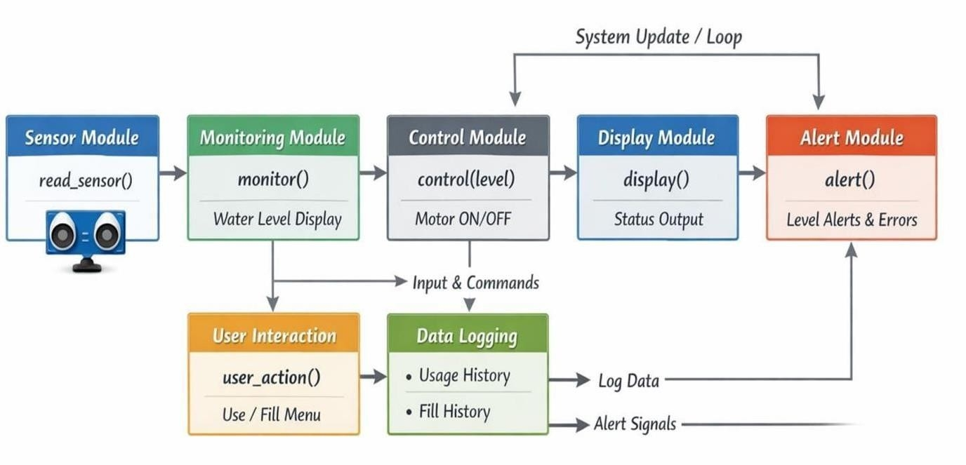
ARCHITECTURE DIAGRAM
06/03/2025
Notes:
9

Slide 14
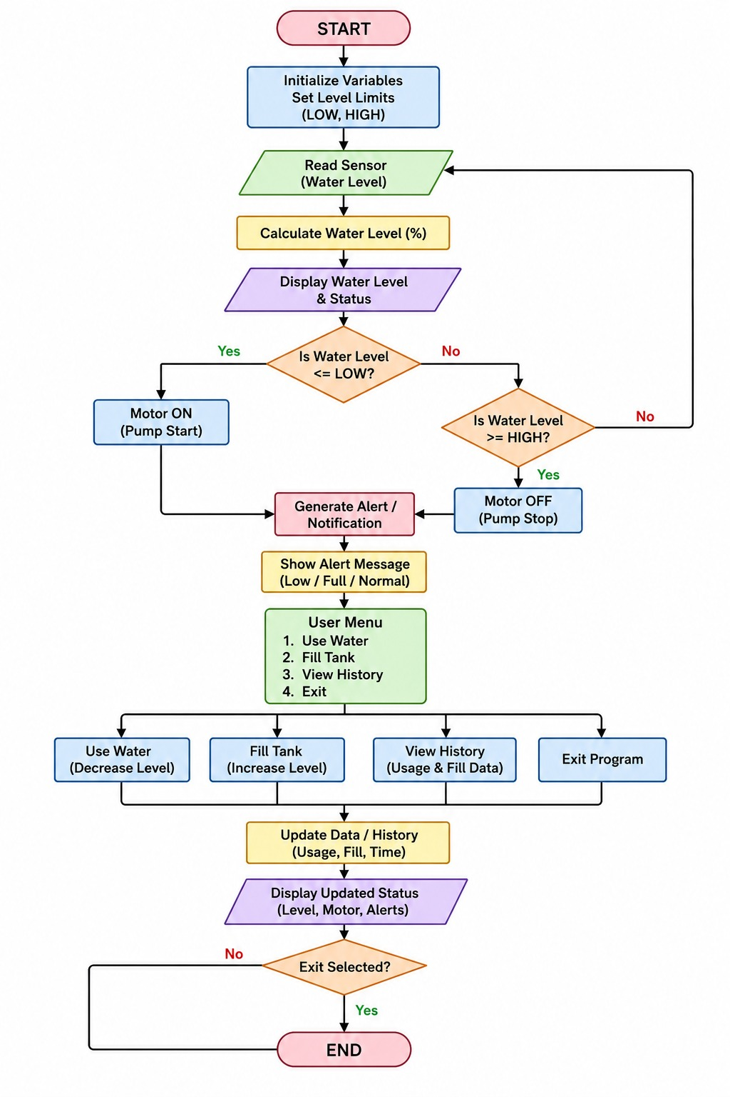
DATA FLOW DIAGRAM(DFD)
06/03/2025
Notes:
10

Slide 15
CONCLUSION
The Smart Water Tank Level Monitoring and Usage System is an efficient and user-friendly solution for monitoring and controlling water levels automatically. The system helps prevent water overflow, reduces water wastage, and minimizes manual effort by automatically controlling the motor based on tank water level. It also provides alert notifications and maintains water usage history for better monitoring and management. Overall, the project improves efficient water utilization and can be further developed into a real-time IoT-based smart water management system.
06/03/2025
Notes:
10

Slide 16
PROGRAM
# MODULE 1:MONITORING
def monitor():
print("\n📡 SENSOR STATUS")
print(f"Water Level : {water_level}%")
return water_level
# MODULE 2: MOTOR CONTROL
def control(level):
global motor_on
print("\n⚙️ MOTOR CONTROL") if level
<= LOW:
motor_on = True
print("⚠️ Low Level → Motor ON")
elif level >= HIGH:
motor_on = False
print("✅ Tank Full→ Motor OFF")
else:
print("✔️ Level Normal")
import random
import time
fromdatetime import datetime
LOW = 30
HIGH = 90
# SENSOR (SIMULATED)
def read_sensor():
return random.randint(20, 80)
water_level = read_sensor()
motor_on = False
total_usage = 0
usage_history = []
fill_history = []
def header():
now = datetime.now()
print("\n" + "=" * 50)
print("💧 SMART WATER TANK SYSTEM 💧")
print("📅 Date:", now.strftime("%d-%m-%Y"))
print("🕒 Time:", now.strftime("%H:%M:%S"))
print("=" * 50)
06/03/2025
Notes:
10

Slide 17
PROGRAM
usage_history.append((used, now))
print(f"🚿 Used {used}% water at {now}")
# -------- FILL WATER --------
elif choice == "2":
if motor_on:
added = int(input("Enter water to add (%): "))
if water_level + added > 100:
print("❌ ERROR: Tank will overflow!")
print(f"Current level: {water_level}%")
print(f"You can only add up to {100 - water_level}%")
print("🚨 ALERT: Overflow prevented")
else:
water_level += added
now = datetime.now().strftime("%H:%M:%S")
fill_history.append((added, now))
print(f"💧 Added {added}% water at {now}")
else:
print("❌Motor OFF → Cannot Fill")
# -------- VIEW USAGE HISTORY --------
elif choice == "3":
print("\n📊USAGE HISTORY")
if not usage_history:
print("No usage yet")
# MODULE 3: USER ACTION + VALIDATION + DATA
def user_action():
global water_level, total_usage, usage_history, fill_history
print("\n👤 USER MENU")
print("1. Use Water")
print("2. Fill Tank")
print("3. View Usage History")
print("4. View Fill History")
print("5. Exit")
choice = input("Enter choice: ")
# -------- USE WATER --------
if choice == "1":
used = int(input("Enter water used (%): "))if used > water_level:
print("❌ ERROR: Not enough water in tank!")
print(f"Available water: {water_level}%")
print("🚨 ALERT: Usage exceeds available water")
else:
water_level -= used
total_usage += used
now = datetime.now().strftime("%H:%M:%S")
06/03/2025
Notes:
10

Slide 18
PROGRAM
print(f"Water Level : {water_level}%")
print(f"Motor : {'ON' if motor_on else 'OFF'}")
print(f"Total Usage : {total_usage} units")
print("-" *40)
# MODULE 5: ALERT SYSTEM (DETAILED)
def alert():
print("\n🚨 ALERT SYSTEM")
if water_level <= 5:
print("🔴 CRITICAL: Tank Almost Empty (0-5%)")
elif water_level <= 15:
print("□ VERY LOW:Water Level Very Low (6-15%)")elif water_level <= 30:
print("□ LOW: Water Level Low (16-30%)")
elif water_level <= 60:
print("□ NORMAL: Water Level Medium (31-60%)")
elif water_level <= 85:
print("🔵 HIGH: Water Level High (61-85%)")
elif water_level < 100:
print("□ VERY HIGH: Tank Almost Full (86-99%)")
elif water_level == 100:
print("🔴 FULL: Tank Completely Full(100%)")
else:
for u, t in usage_history:
print(f"Used {u}% at {t}")
elif choice == "4":print("\n💧 FILL HISTORY")
if not fill_history:
print("No filling yet")
else:
for f, t in fill_history:
print(f"Added {f}% at {t}")
# EXIT
elif choice == "5":
return False
else:
print("❌ Invalid Choice")
water_level = max(0, min(100, water_level))
return True
# MODULE 4:DISPLAY
def display():
print("\n📊 SYSTEM STATUS")
print("-" * 40)
# MAIN SYSTEM
#
header()
print("System Started...")
# FIRST SENSOR DISPLAY
level= monitor()
control(level)
display()
alert()
# INTERACTIVE LOOP
while True:
if not user_action():
print("\n👋SystemStopped")
break
header()
level= monitor()
control(level)
display()
alert()
time.sleep(1)
06/03/2025
Notes:
10

Slide 19
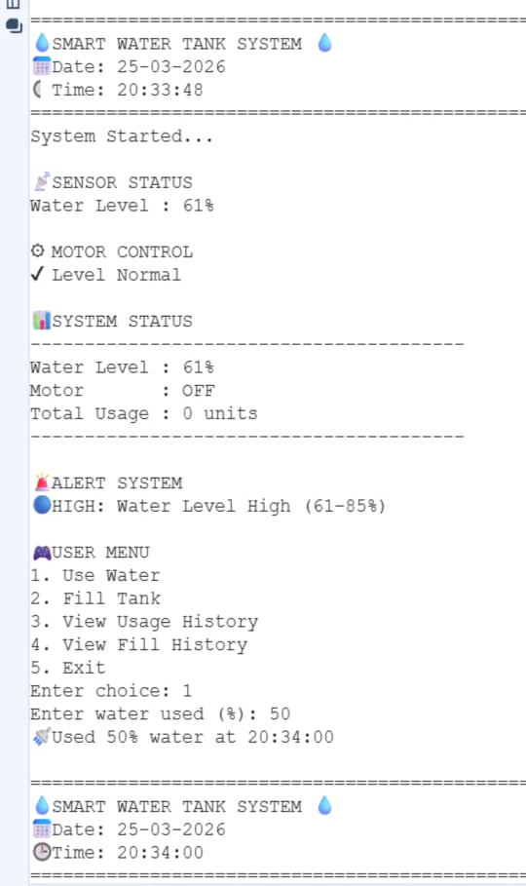
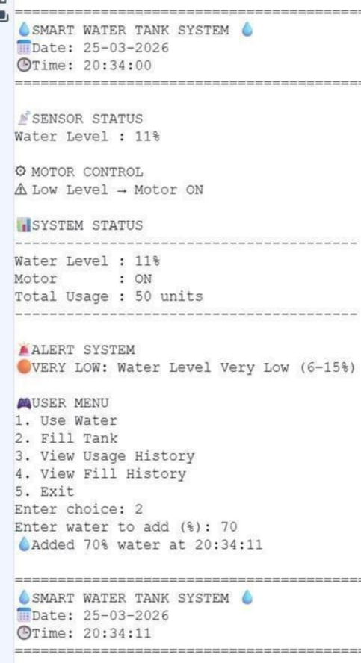
OUTPUT-SCREENSHOTS

Slide 20
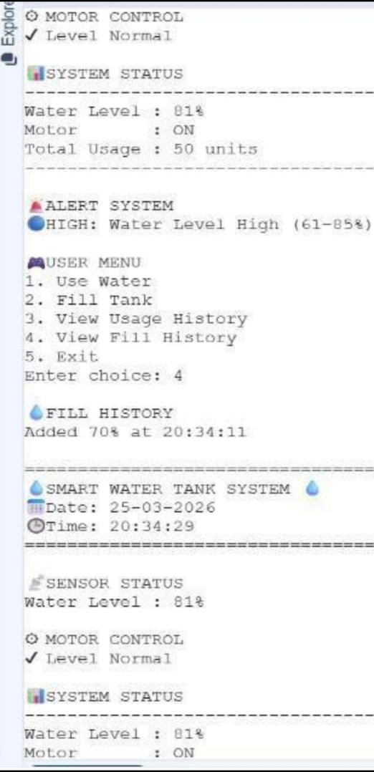
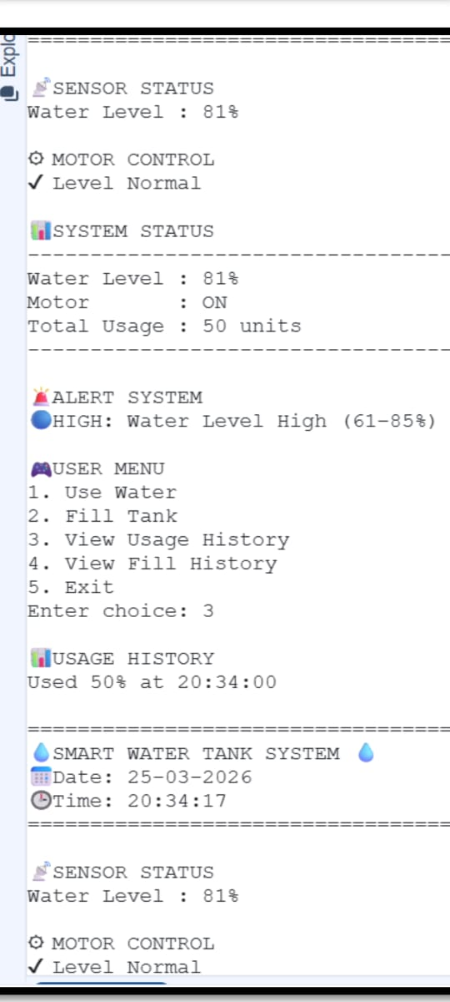
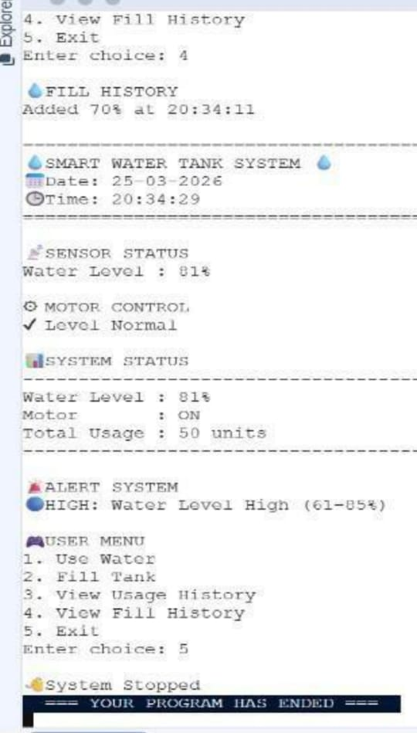
OUTPUT-SCREENSHOTS

